Slide 1

神经网络结构介绍

Slide 2
VGG
VERY DEEP CONVOLUTIONAL NETWORKS FOR LARGE-SCALE IMAGE RECOGNITION

Slide 3
VGG和AlexNet比较
VGGNet做出的主要工作：
加深网络深度
使用更小的filter

Slide 4
VGG和AlexNet比较
VGGNet做出的主要工作：
加深网络深度
使用更小的filter
8层 (AlexNet)
16-19层 (VGG)
只使用了3×3的Conv stride=1 pad=1
2×2的Max Pool stride=2

Slide 5
为什么使用3×3的卷积
2个3×3的filter(s=1)
一个5×5的filter(s=1)
3个3×3的filter(s=1)
一个7×7的filter(s=1)
1、3个3×3的filter会额外的引入两个ReLU激活函数，这样可以增加模型的非线性程度

Slide 6
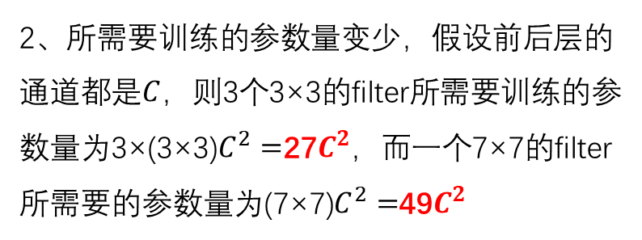
为什么使用3×3的卷积
2个3×3的filter(s=1)
一个5×5的filter(s=1)
3个3×3的filter(s=1)
一个7×7的filter(s=1)
1、3个3×3的filter会额外的引入两个ReLU激活函数，这样可以增加模型的非线性程度
2、所需要训练的参数量变少，假设前后层的通道都是$C$，则3个3×3的filter所需要训练的参数量为3×(3×3)$C^{2}=$27$C^{2}$，而一个7×7的filter所需要的参数量为(7×7)$C^{2}=$49$C^{2}$

Slide 7
INPUT: [224x224x3] memory: 224*224*3=150K params: 0
CONV3-64: [224x224x64] memory: 224*224*64=3.2M params: (3*3*3)*64 = 1,728
CONV3-64: [224x224x64] memory: 224*224*64=3.2M params: (3*3*64)*64 = 36,864
POOL2: [112x112x64] memory: 112*112*64=800K params: 0
CONV3-128: [112x112x128] memory: 112*112*128=1.6M params: (3*3*64)*128 = 73,728
CONV3-128: [112x112x128] memory: 112*112*128=1.6M params: (3*3*128)*128 = 147,456
POOL2: [56x56x128] memory: 56*56*128=400K params: 0
CONV3-256: [56x56x256] memory: 56*56*256=800K params: (3*3*128)*256 = 294,912
CONV3-256: [56x56x256] memory: 56*56*256=800K params: (3*3*256)*256 = 589,824
CONV3-256: [56x56x256] memory: 56*56*256=800K params: (3*3*256)*256 = 589,824
POOL2: [28x28x256] memory: 28*28*256=200K params: 0
CONV3-512: [28x28x512] memory: 28*28*512=400K params: (3*3*256)*512 = 1,179,648
CONV3-512: [28x28x512] memory: 28*28*512=400K params: (3*3*512)*512 = 2,359,296
CONV3-512: [28x28x512] memory: 28*28*512=400K params: (3*3*512)*512 = 2,359,296
POOL2: [14x14x512] memory: 14*14*512=100K params: 0
CONV3-512: [14x14x512] memory: 14*14*512=100K params: (3*3*512)*512 = 2,359,296
CONV3-512: [14x14x512] memory: 14*14*512=100K params: (3*3*512)*512 = 2,359,296
CONV3-512: [14x14x512] memory: 14*14*512=100K params: (3*3*512)*512 = 2,359,296
POOL2: [7x7x512] memory: 7*7*512=25K params: 0
FC: [1x1x4096] memory: 4096 params: 7*7*512*4096 = 102,760,448
FC: [1x1x4096] memory: 4096 params: 4096*4096 = 16,777,216
FC: [1x1x1000] memory: 1000 params: 4096*1000 = 4,096,000
总内存: 24M * 4 bytes ~= 96MB / image (只是前向传播 ~*2 反向传播)
总参数: 138M 参数

Slide 8
INPUT: [224x224x3] memory: 224*224*3=150K params: 0
CONV3-64: [224x224x64] memory: 224*224*64=3.2M params: (3*3*3)*64 = 1,728
CONV3-64: [224x224x64] memory: 224*224*64=3.2M params: (3*3*64)*64 = 36,864
POOL2: [112x112x64] memory: 112*112*64=800K params: 0
CONV3-128: [112x112x128] memory: 112*112*128=1.6M params: (3*3*64)*128 = 73,728
CONV3-128: [112x112x128] memory: 112*112*128=1.6M params: (3*3*128)*128 = 147,456
POOL2: [56x56x128] memory: 56*56*128=400K params: 0
CONV3-256: [56x56x256] memory: 56*56*256=800K params: (3*3*128)*256 = 294,912
CONV3-256: [56x56x256] memory: 56*56*256=800K params: (3*3*256)*256 = 589,824
CONV3-256: [56x56x256] memory: 56*56*256=800K params: (3*3*256)*256 = 589,824
POOL2: [28x28x256] memory: 28*28*256=200K params: 0
CONV3-512: [28x28x512] memory: 28*28*512=400K params: (3*3*256)*512 = 1,179,648
CONV3-512: [28x28x512] memory: 28*28*512=400K params: (3*3*512)*512 = 2,359,296
CONV3-512: [28x28x512] memory: 28*28*512=400K params: (3*3*512)*512 = 2,359,296
POOL2: [14x14x512] memory: 14*14*512=100K params: 0
CONV3-512: [14x14x512] memory: 14*14*512=100K params: (3*3*512)*512 = 2,359,296
CONV3-512: [14x14x512] memory: 14*14*512=100K params: (3*3*512)*512 = 2,359,296
CONV3-512: [14x14x512] memory: 14*14*512=100K params: (3*3*512)*512 = 2,359,296
POOL2: [7x7x512] memory: 7*7*512=25K params: 0
FC: [1x1x4096] memory: 4096 params: 7*7*512*4096 = 102,760,448
FC: [1x1x4096] memory: 4096 params: 4096*4096 = 16,777,216
FC: [1x1x1000] memory: 1000 params: 4096*1000 = 4,096,000
第一层卷积的内存开销最大
第一层全连接层的计算开销最大
总内存: 24M * 4 bytes ~= 96MB / image (只是前向传播 ~*2 反向传播)
总参数: 138M 参数

Slide 9
VGGNet的细节
1、在ILSVRC’14的比赛中获得了分类组的第二名，定位组的第一名。
2、训练过程和AlexNet很相似
3、没有采用局部响应归一化(LRN)
4、VGG在其他任务上泛化很好。

Slide 10
谢谢观看

